Slide 1
Localization and Mapping for Mobile Robot
Faculty of Computer Science
Big Data and Information Retrieval School
Moscow 2022
Type: Software Project
Kind: Group Project
Author: Daria Andreevna Lapko, DSBA 201
Supervisor: Denis Andreevich Simagin, MSc in Computer Science, HSE FCS, Robotics Group

Slide 2
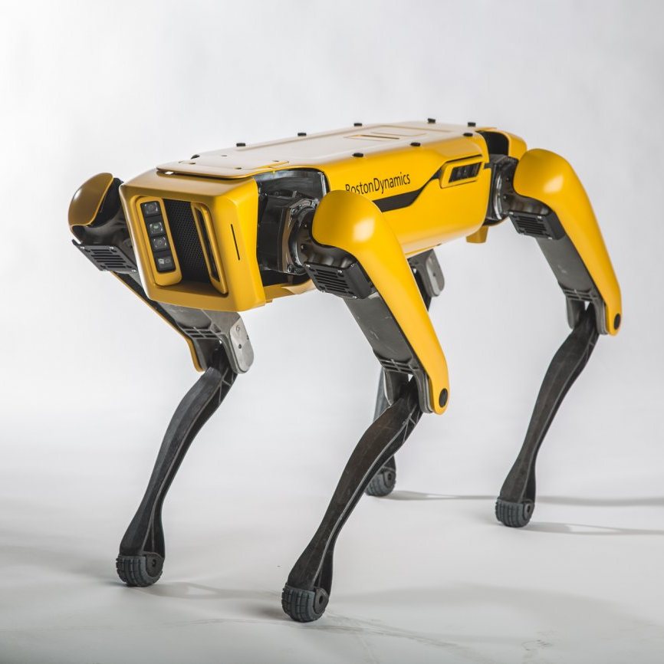
Description of the Subject Area - Robotics
Big Data and Information Retrieval School
Localization and Mapping for Mobile Robot
1980s: the commercial distribution of robots covered the whole world
Late 1990s: active industry development, new programming languages and controllers appear
2000s: first humanoid robots are created, which are able to imitate humans’ actions and feelings
Now, robots are used in nearly every sphere, from manipulators, which build cars on factories, to animal- and human-like machines that can mimic facial expressions and perform complicated sensor-related tasks
Spot, Robot Dog from Boston Dynamics
Source: https://robroy.ru/robot-ot-boston-dynamics-spot-poyavitsya-na-ryinke.html

Slide 3
Basic Terms, Abbreviations and Definitions
Big Data and Information Retrieval School
Localization and Mapping for Mobile Robot
SLAM – acronym for Simultaneous Localization and Mapping; a problem of creating a map of an unknown environment and keeping track of a target object’s location simultaneously within this environment
ROS – acronym for Robot Operating System; an open-source collection of software frameworks for robot development
ROS node – basically, the “smallest” unit in the ROS environment; an executable file that uses the ROS library to connect with other nodes, performing its individual process within the program
IMU – acronym for Inertial Measurement Unit; a device used to measure the acceleration and rotation (orientation in space) of the object it is installed in
SDK – acronym for Software Development Kit; collection of software development tools in a single installable package

Slide 4
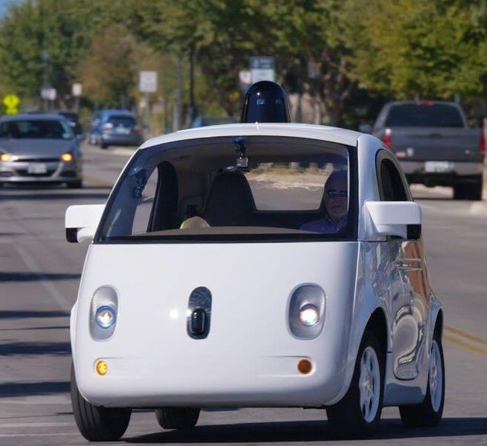
The Relevance of Work
Big Data and Information Retrieval School
Localization and Mapping for Mobile Robot
SLAM is the main algorithm used by autonomous vehicles to find their way in the world
Localization allows to find position and orientation of the vehicle, mapping complements it with centimeter-level accuracy and location of surrounding obstacles
Compared to GPS, SLAM provides a lot more accurate location data, since its range of view is in between 0.3m and 200m
The simplest examples of machines that use SLAM are self-driving cars, planetary rovers and robotic vacuum cleaners
Waymo self-driving car
Source: https://econet.ru/articles/185305-u-bespilotnyh-mashin-waymo-obnaruzhili-problemy-s-povorotami

Slide 5
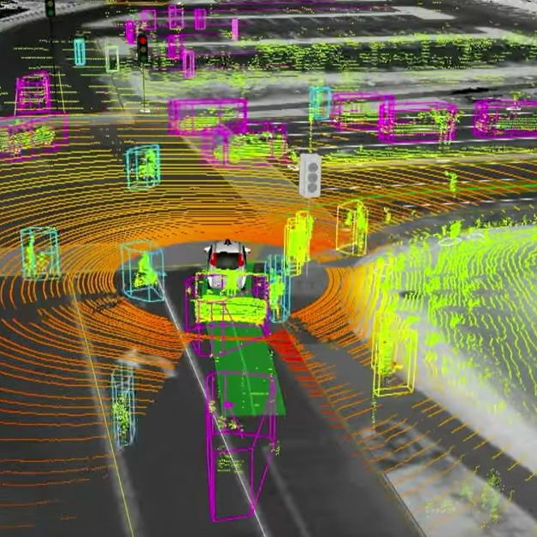
Purpose and Tasks
Big Data and Information Retrieval School
Localization and Mapping for Mobile Robot
General purpose: to develop and implement several algorithms that would allow a mobile robot to localize in an unknown environment and construct a map of its surroundings simultaneously
Each member of the team was assigned a separate task dedicated to solving a problem of SLAM
My main task was to perform the integration of a depth camera into the operating system used within the robot
This task included the following subtasks:
Learn to work with ROS
Set up the depth camera
Connect these to work smoothly and effectively
Example of SLAM algorithm in use
Source: https://pin.it/2vl7JTW

Slide 6
Functional Requirements
Big Data and Information Retrieval School
Localization and Mapping for Mobile Robot
ROS node accepts a depth image as an input
ROS node publishes messages with depth images to the specified topic
Along with the images themselves, the general data about format, publish time, image size, frame ID is published in the same message
Depth images are colorized according to the depth data for better perception by the human eye
Depth images are viewed in Foxglove Studio, which subscribes to the mentioned topics
The data is published in topics only if they have a subscriber

Slide 7
Non-Functional Requirements
Big Data and Information Retrieval School
Localization and Mapping for Mobile Robot
Work with ROS node is intended to be done through Docker image on Linux Ubuntu 18.04
The user is expected to provide the image data from a specified camera type, Intel RealSense D435i
Depth data is accepted as grayscale 16-bit image through the usage of specific RealSense depth image format Z16
The recommended image size is 848 x 420 pixels
The output image format is BGR8 (3-channel 8-bit image)
The colorization is performed with the usage of Hue color scheme
Inside the node, images data is converted from RealSense format to ROS messages via OpenCV and cv_bridge
Foxglove Studio should subscribe to the mentioned topics through rosbridge

Slide 8
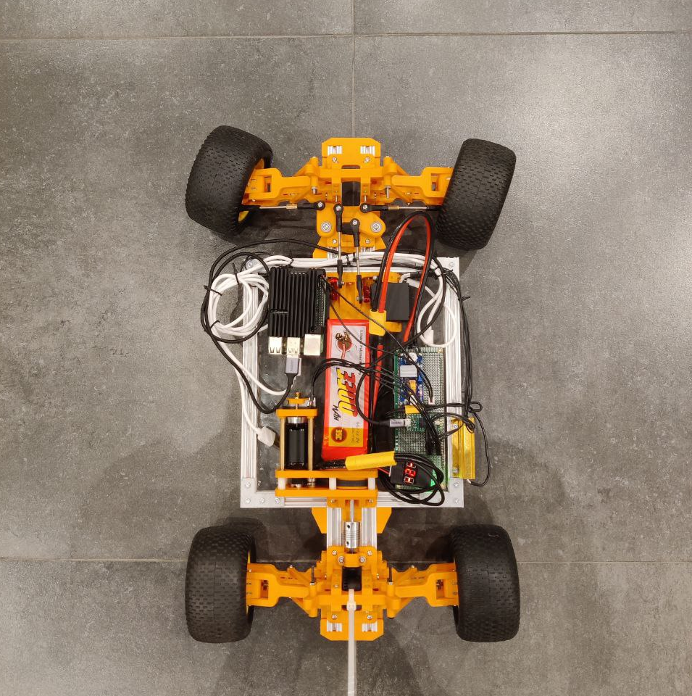
Analysis of Existing Methods
Big Data and Information Retrieval School
Localization and Mapping for Mobile Robot
This project was done within the self-driving robot car project, which is currently being developed in the robotics laboratory
Due to specific requirements and constraints for the robot’s best performance, the instruments for work were chosen beforehand and given to me
Nevertheless, I will inspect the chosen methods and instruments and outline their positive and negative sides
Robot car, developed within self driving robot car project of Robotics group
Source: Robotics group photographer

Slide 9
The Choice of Instruments
Big Data and Information Retrieval School
Localization and Mapping for Mobile Robot
ROS:
provides developers with a universal architecture that combines a variety of ready-to-use algorithms applicable for a multitude of purposes
exists in 2 versions, ROS 1 and ROS 2, Here, ROS 2 is being used due to its better stability, real-time robot control ability, improved supported languages, and an ability to control the node status (hence, all following mentions of ROS will be related to ROS 2)
Intel RealSense D435i:
uses Depth from Stereo technology for acquiring depth, which is the most suitable for a car due to its indoor/outdoor working abilities and good range; owns IMU, which allows tracking robot’s pose and movement
is the best cost-to-performance model in comparison to devices of other brands and among RealSense depth cameras
Other important instruments include: Nvidia Jetson Nano with Linux Ubuntu, Docker, C++, OpenCV, Foxglove Studio, cv_bridge, rosbridge_suite, Tmux

Slide 10
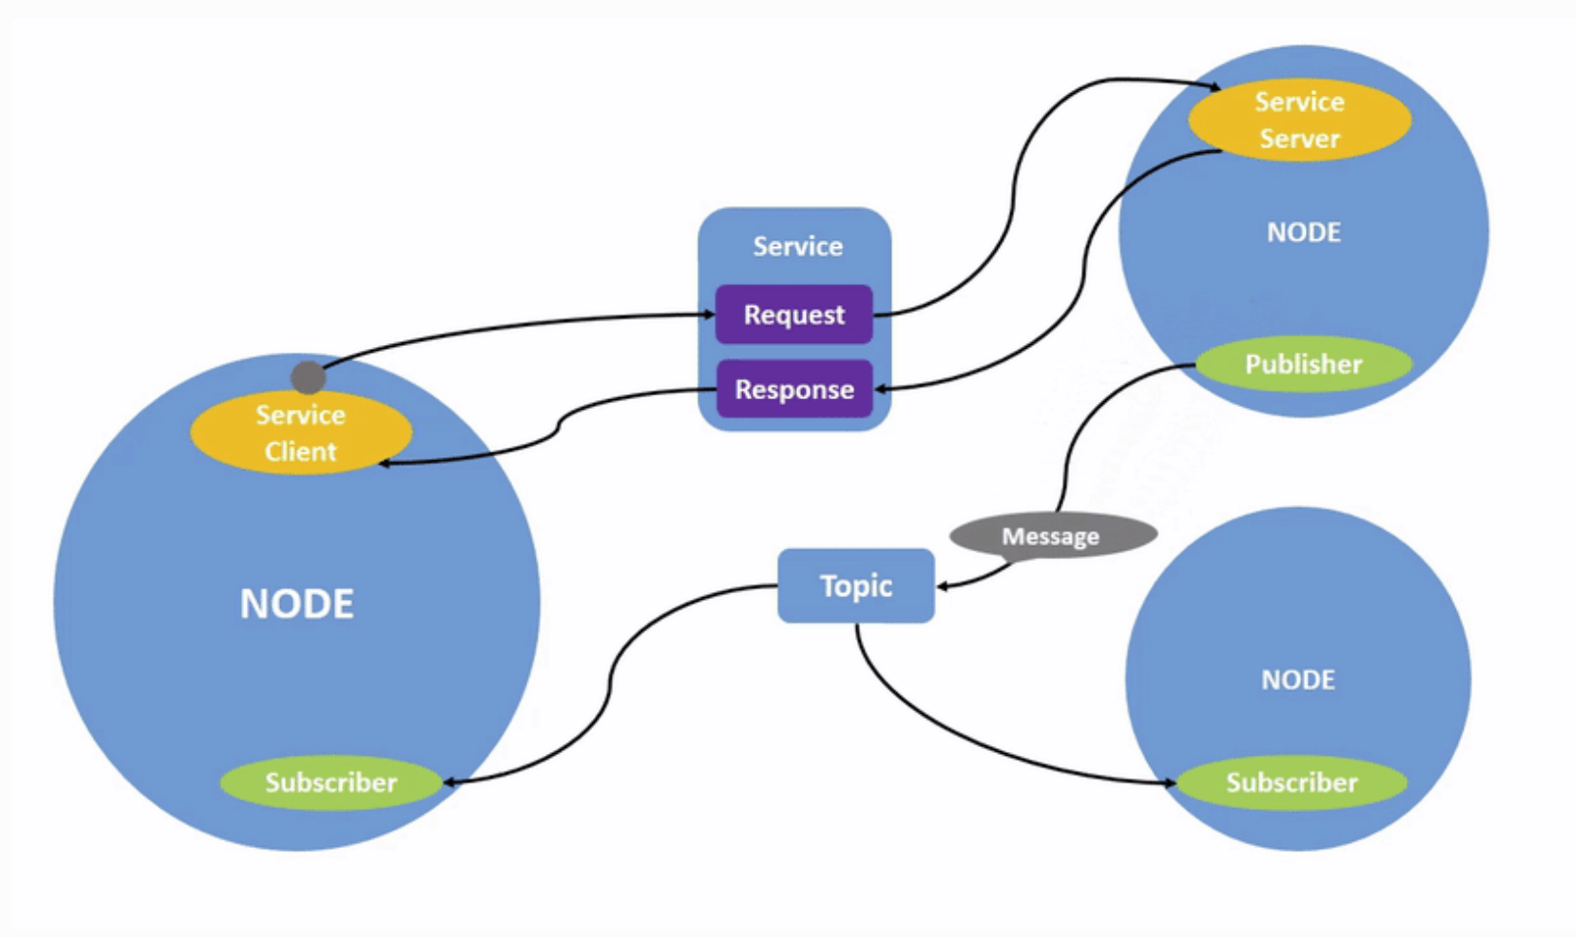
Description of Developed Method: ROS
Big Data and Information Retrieval School
Localization and Mapping for Mobile Robot
ROS architecture consists of independent nodes, each referring to a single specific task that they are required to perform
Nodes can be of 2 types: publisher (passing data) and subscriber (accepting data)
There are also topics, which serve as connecting units between nodes
Process description: publisher node sends data to the connected topic, while subscriber node subscribes to the same topic to access this data
ROS architecture
Source: https://docs.ros.org/en/galactic/Tutorials/Understanding-ROS2-Nodes.html

Slide 11
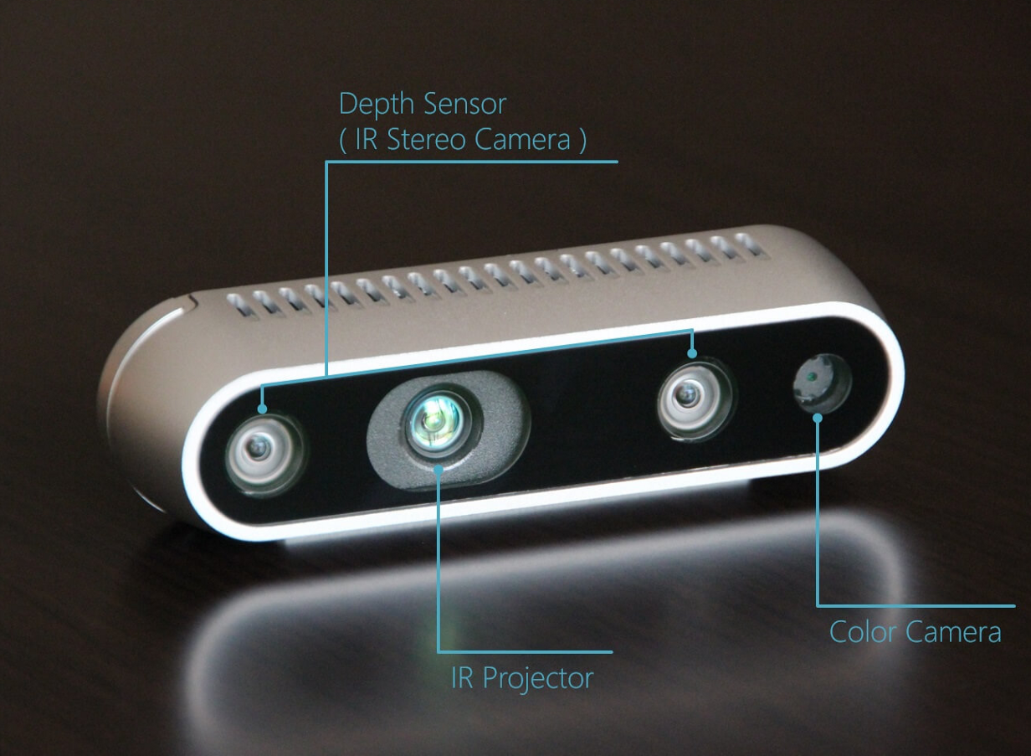
Description of Developed Method: Depth camera
Big Data and Information Retrieval School
Localization and Mapping for Mobile Robot
In a depth camera, every pixel of an image stores a distance value from this point to some objects in their range
The Depth from Stereo camera is used here
Principle:
IR Projector sends the signal to the object
It is collected by the pair of parallel and similarly directed Depth Sensors (or IR Stereo Cameras)
The difference between the key points on the images collected by these sensors, called disparity, is what helps to find depth
Intel RealSense D435i camera body and location of depth-related elements on it
Source: https://medium.com/phygitalism/rgb-d-sensors-devices-430e8782feeb

Slide 12
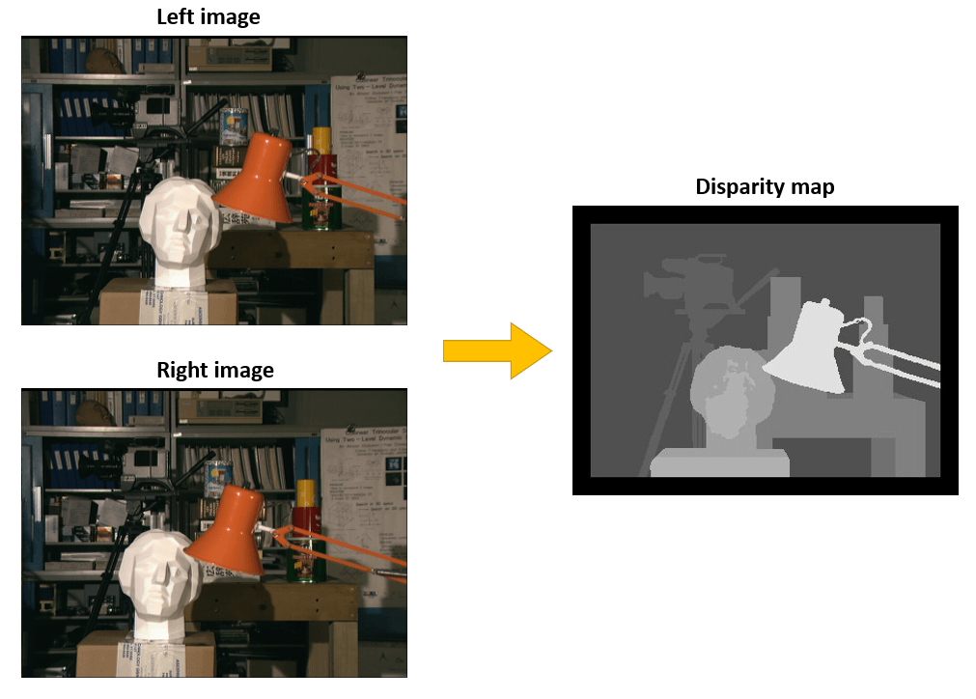
Implementation – Main Algorithm
Big Data and Information Retrieval School
Localization and Mapping for Mobile Robot
The main algorithm is intended to combine ROS and Intel RealSense SDK for best performance of the depth camera inside the ROS system
Steps:
Create the ROS node and launch topics
Acquire a depth image from the RealSense D435i camera
Obtain the OpenCV matrix from depth data
Convert an OpenCV matrix to a ROS message type using cv_bridge
Publish the message to the appropriate topic
Example of how disparity map is obtained. The farther objects are from the camera, the darker they look.
Source: https://www.baeldung.com/cs/disparity-map-stereo-vision

Slide 13
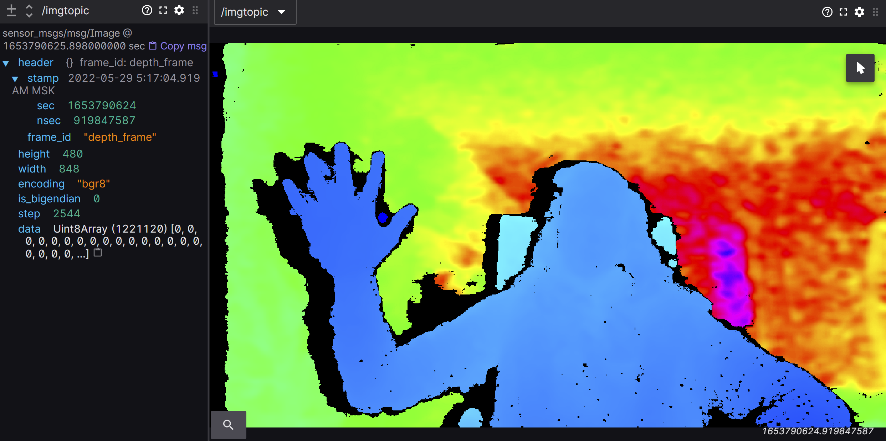
Implementation – Launch and Testing
Big Data and Information Retrieval School
Localization and Mapping for Mobile Robot
The algorithm is implemented in the C++ language and requires additional files to be built: CmakeLists.txt and package.xml
The package is built using colcon - unified build tool that combines several ROS build tools in one
It is required to run rosbridge_suite to connect the ROS server with Foxglove Studio
Now, the main algorithm can be run, working simultaneously with rosbridge to share topics
In Foxglove studio, after connecting through rosbridge, we can see the algorithm result – a topic containing a depth image and information about it
The result of algorithm – depth image; closer objects are colored in blue, and change according to the color circle, finishing at dark purple at the farthest point; information about the image on the left side
Source: my screenshot

Slide 14
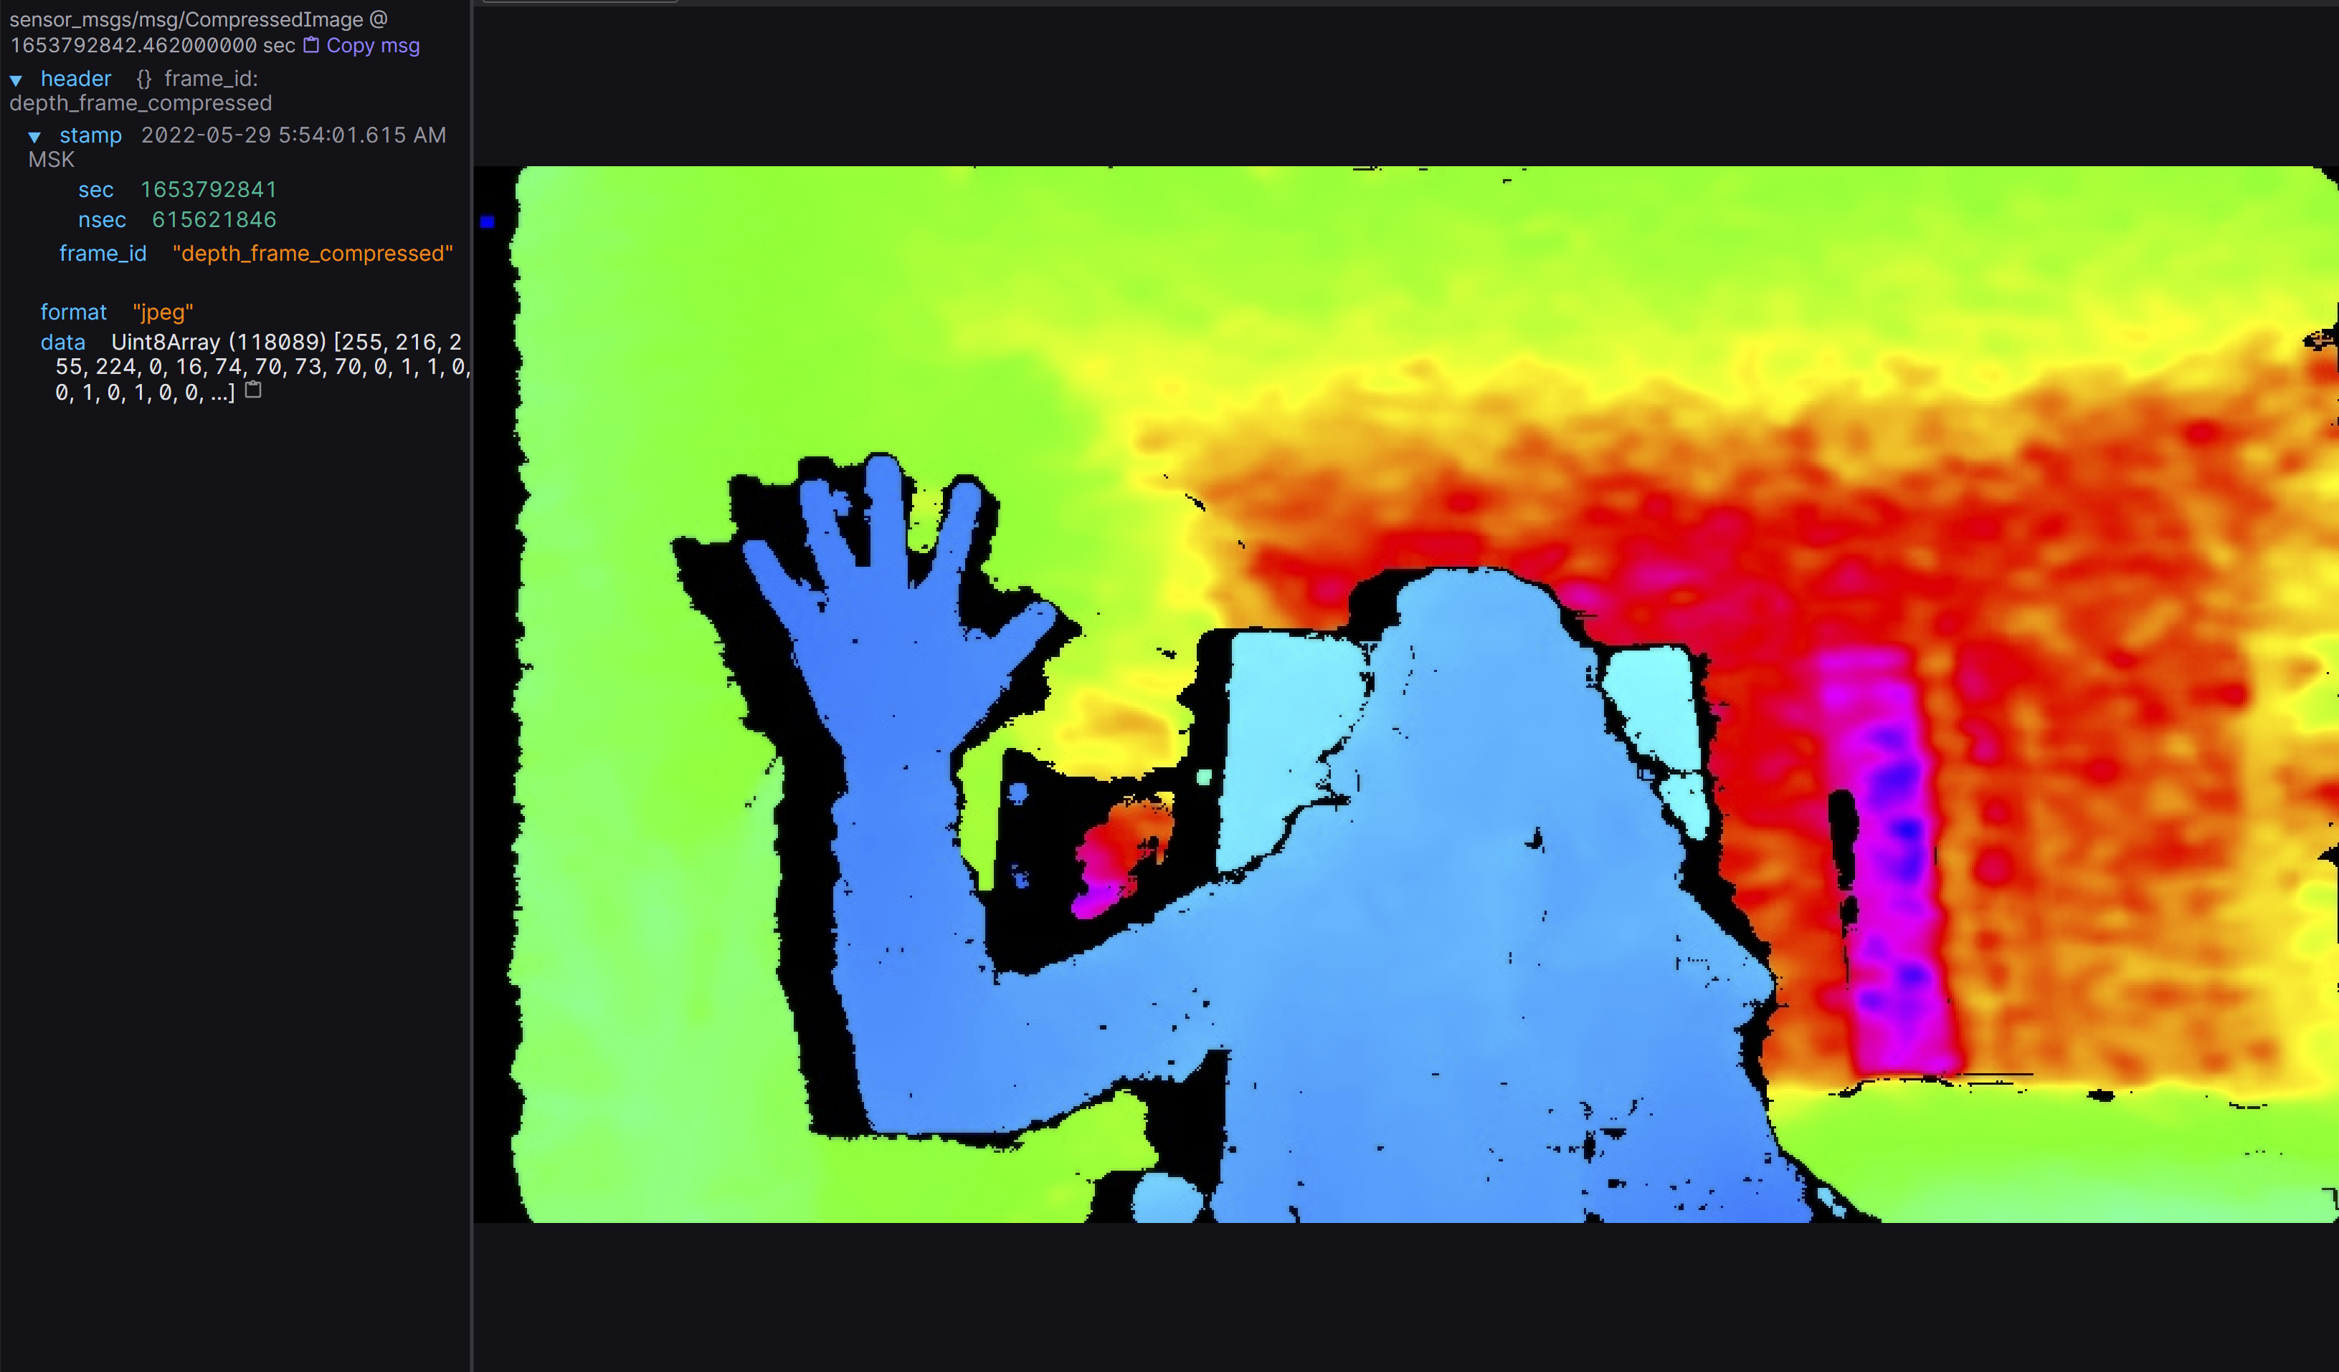
Implementation – Additional Feature: Compression
Big Data and Information Retrieval School
Localization and Mapping for Mobile Robot
The main algorithm is optimized using image compression, which decreases the CPU load
Important for further work of the algorithm on self-driving car robot
The chosen compression method – JPEG
Compression is performed with the help of cv_bridge library functions
Other things being equal, compressed depth image is posted into its own topic and is seen separately from original image in Foxglove studio with all relevant information about it
The result of algorithm – compressed depth image; closer objects are colored in blue, and change according to the color circle, finishing at dark purple at the farthest point; information about the image on the left side
Source: my screenshot

Slide 15
Time to see the algorithm in use!
Big Data and Information Retrieval School
Localization and Mapping for Mobile Robot

Slide 16
Main results and conclusions
Big Data and Information Retrieval School
Localization and Mapping for Mobile Robot
The initially stated goal was achieved completely as required; an additional compression algorithm was implemented
Compression showed good performance: image size reduced without visible quality loss
Practically significant work: part of the self-driving car robot algorithms rely on this project
Got a chance to work with camera structure and computer vision algorithms, in which I am largely interested
Plenty of new knowledge about previously unencountered topics and instruments: ROS, cv_bridge, Docker, etc.
Additional practice of C++ code writing, exploring libraries’ documentation, using Linux features and terminal
Experience of working in team with professionals of different robotics-related spheres

Slide 17
Directions for Further Work
Big Data and Information Retrieval School
Localization and Mapping for Mobile Robot
Optimization of the algorithm for use with self-driving car robot
Change the image format from BGR8 to MONO16 (grey scale image), so that the robot can process it more easily
Perform image compression through nvJPEG – Nvidia library that allows for the use of GPU resources for more optimal image encoding and deconding
Publish video frame instead of image frames to topic
As soon as all possible optimization is done, it is possible to move on to real SLAM algorithm implementation

Slide 18
Sources
Big Data and Information Retrieval School
Localization and Mapping for Mobile Robot
Kron, Andrej. “Roboty v Chelovecheskom Obshchestve.” Habr, Habr, 16 Sept. 2017, https://habr.com/ru/company/unet/blog/337902/. [Last accessed 05/06/2022]
Igor'. “Kak Eto Ustroeno: Robot Spot Ot Boston Dynamics.” Habr, Habr, 9 Nov. 2020, https://habr.com/ru/post/521878/. [Last accessed 05/06/2022]
“Waymo Driver.” Waymo, Waymo, https://waymo.com/waymo-driver/. [Last accessed 05/06/2022]
“Spot® - The Agile Mobile Robot.” Boston Dynamics, Boston Dynamics, https://www.bostondynamics.com/products/spot. [Last accessed 05/06/2022]
Agarwal, Divya. “How Slam Works for Self-Driving Cars: A Brief but Detailed Overview.” How Slam Works, AutoVision News, 5 June 2020, https://www.autovision-news.com/adas/how-slam-works/. [Last accessed 05/06/2022]

Slide 19
Thank you for your attention! I am ready to answer your questions!
Big Data and Information Retrieval School
Localization and Mapping for Mobile Robot

